Slide 1
SUS TEST RESULTS
(Wednesday Apr 21, 2021 – Wednesday May 5, 2021)

Slide 2
What is SUS (System Usability Scale) Test?
The System Usability Scale (SUS) provides a “quick and dirty”, reliable tool for measuring the usability. It consists of a 10 item questionnaire with five response options for respondents; from Strongly agree to Strongly disagree.*
*https://www.usability.gov/how-to-and-tools/methods/system-usability-scale.html

Slide 3
Why SUS Test?
To… meet our user’s needs, provide positive experiences, keep users loyal to “- Any tool- ” and reduce customer churn.

Slide 4
Benefits of using a SUS
SUS has become an industry standard, with references in over 1300 articles and publications. The noted benefits of using SUS include that it:
Is a very easy scale to administer to participants
Can be used on small sample sizes with reliable results
Is valid – it can effectively differentiate between usable and unusable systems*
Meeting user’s needs results in loyalty
Reduces customer churn
Results in higher NPS scores, a larger number of ambassadors (NPS score 9-10)
and grow revenue through referrals and upsells.
*https://www.usability.gov/how-to-and-tools/methods/system-usability-scale.html

Slide 5
Calculating System Usability Scale (SUS) Score
Step 1
Convert the scale into number for each of the 10 questions
Strongly Disagree: 1 point
Disagree: 2 points
Neutral: 3 points
Agree: 4 points
Strongly Agree: 5 points
(negative question patterns uses an opposite calculation) *
*https://uiuxtrend.com/measuring-system-usability-scale-sus/

Slide 6
Calculating System Usability Scale (SUS) Score
Step 2
X = Sum of the points for all odd-numbered questions – 5
Y = 25 – Sum of the points for all even-numbered questions
SUS Score = (X + Y) x 2.5 *
*https://uiuxtrend.com/measuring-system-usability-scale-sus/

Slide 7
Interpreting System Usability Scale (SUS) Score
SUS score will be able to tell you your usability performance in the aspects of effectiveness, efficiency, and overall ease of use. Although each response yield a score on a scale of 0 – 100, do not mistake it as a percentage or percentile.*
The SUS score describes the usability performance of “Any tool” in terms of efficiency, efficiency, and general ease of use.
*https://uiuxtrend.com/measuring-system-usability-scale-sus/

Slide 8
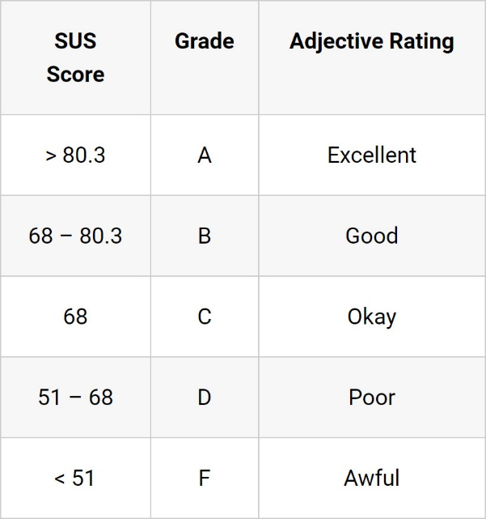
Interpreting System Usability Scale (SUS) Score
The general average SUS score is 68. (In this research, the “any tool” SUS test result is 63.5.)
This simply means that a score of 68 will just put you at 50th percentile. Below is the general guideline on the interpretation of the SUS score:
*https://uiuxtrend.com/measuring-system-usability-scale-sus/

Slide 9
“- Any tool- ” SUS Test
SUS test was created in 2 different languages for our users who speak English and Dutch.
The SUS test was shared with 1650 people in total, and a total of 41 answers were received.
Response rate: 2.48%

Slide 10
SUS Test (Dutch version)
Views
50
Views
35
Responses
28
Completion Rate
80%
Average time to complete
01:20
SUS Test Average: 61 (1710 point / 28)

Slide 11
SUS Test (English version)
Views
43
Starts
23
Responses
13
Completion Rate
56.5%
Average time to complete
04:15
SUS Test Average: 66 (857.5 point / 13)

Slide 12
SUS Test (Average)
Views
47
Starts
29
Responses
20
Completion Rate
68.9%
Average time to complete
02:48
SUS Test Average: 63.5

Slide 13
Which company employees answered the test
Company A (2 person)
Company B
Company C (2 person)
Company D
Company E
Company F (2 person)
Company G
Company H
Company I
Company J (2 person)
Company K
Company L (2 person)
Company M
Company N
Company O
Company P (2 person)
Company Q
Company R
Company S
Company T
Company U
Company V
Company W
Company X
Company Y
Company Z
Company AA
Company AB (2 person)
Company AC
Company AD
Company AE (3 person)
Totally 30 company

Slide 14
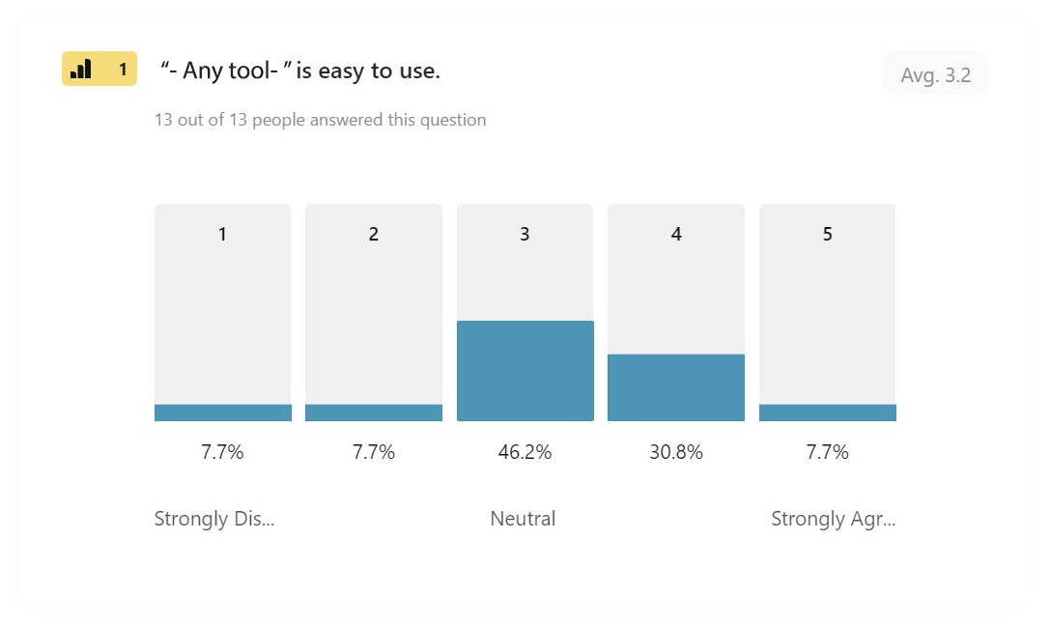
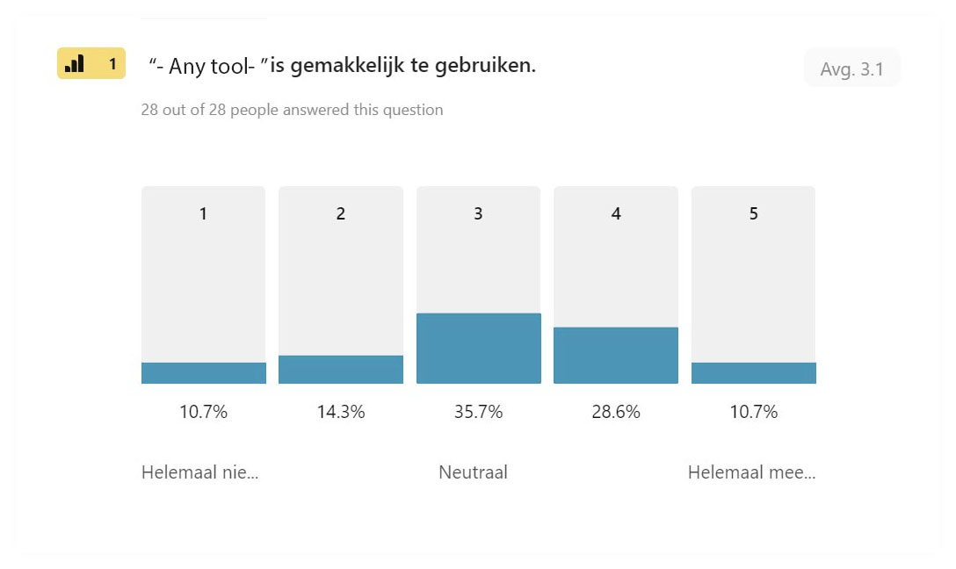
Questions & Answers #1
“- Any tool- ” is easy to use.
General Average
Strongly Disagree
9.2%
Slightly Disagree
11%
Neutral
40.9%
Slightly Agree
29.7%
Strongly Agree
9.2%

Slide 15
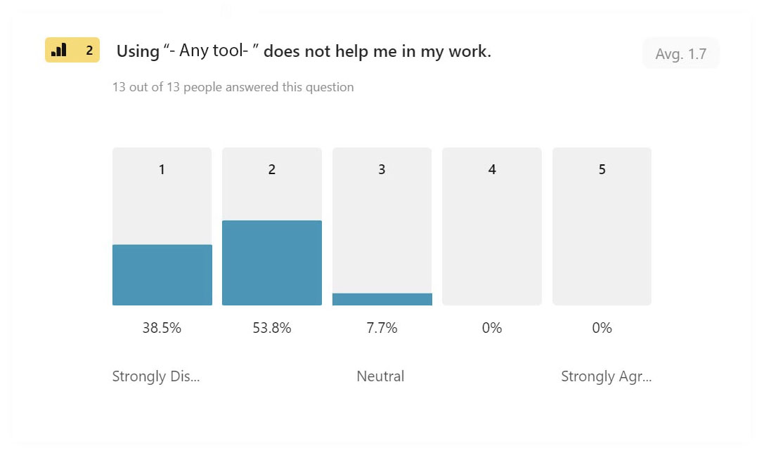
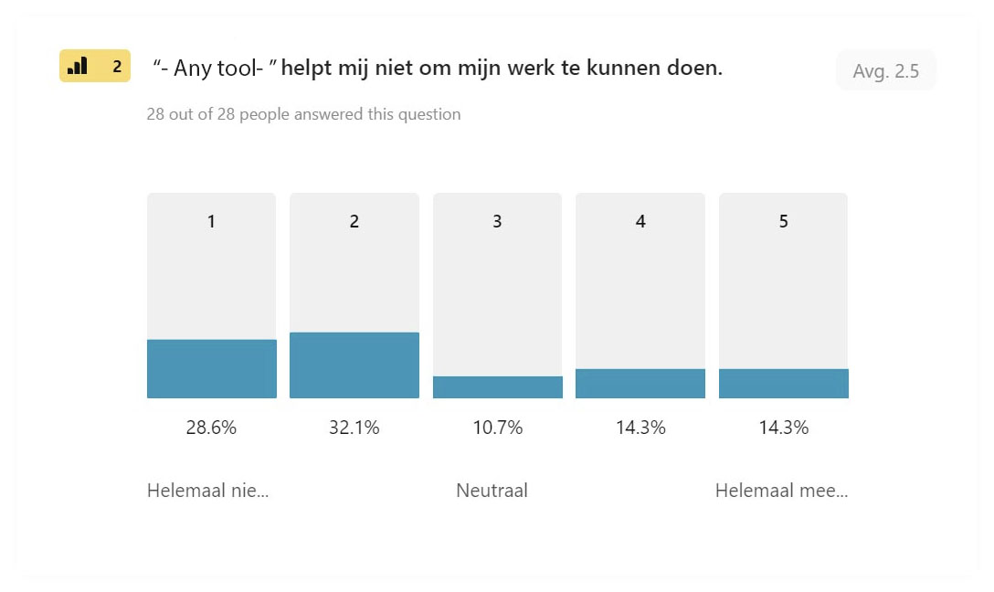
Questions & Answers #2
Using “- Any tool- ” does not help me in my work.
General Average
Strongly Disagree
33.4%
Slightly Disagree
43%
Neutral
9.2%
Slightly Agree
7.2%
Strongly Agree
7.2%

Slide 16
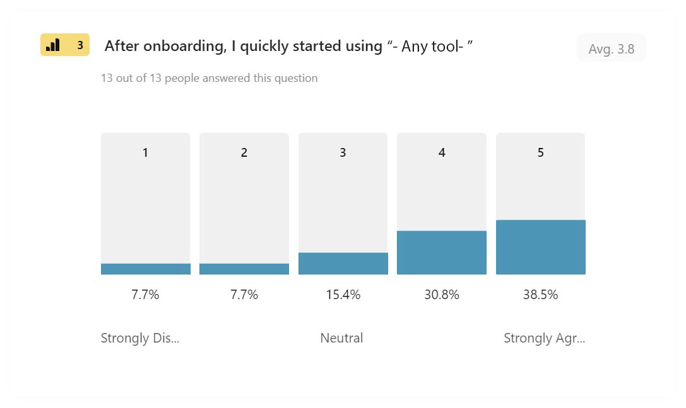
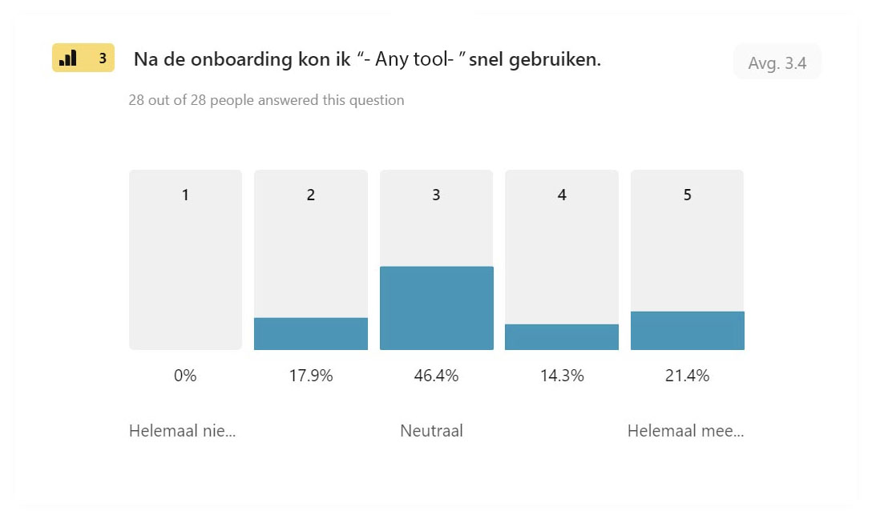
Questions & Answers #3
After onboarding, I quickly started using “- Any tool- ”.
General Average
Strongly Disagree
3.9%
Slightly Disagree
12.8%
Neutral
30.9%
Slightly Agree
22.5%
Strongly Agree
29.9%

Slide 17
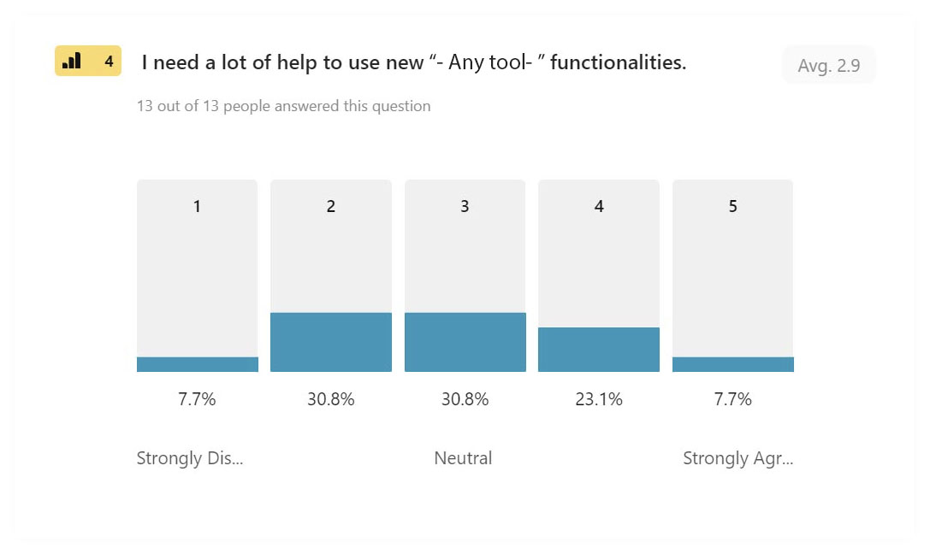
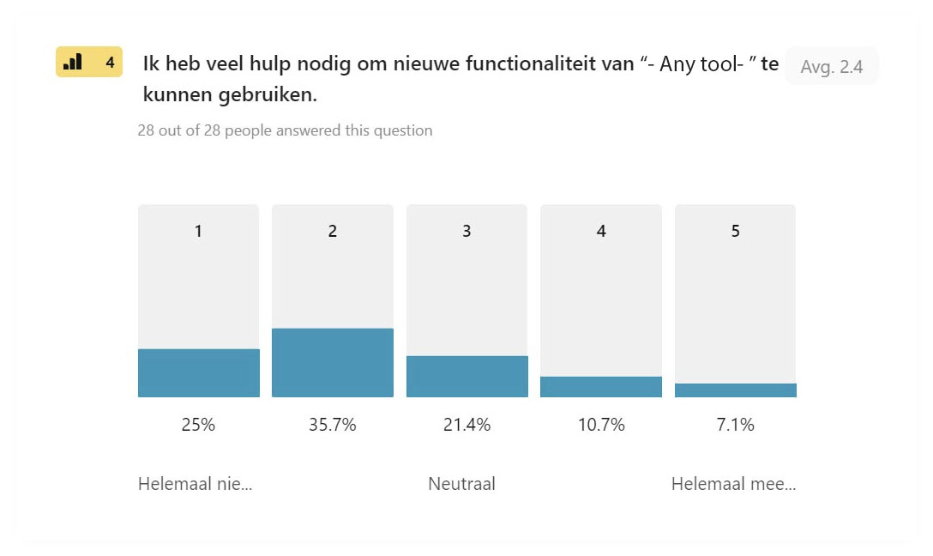
Questions & Answers #4
I need a lot of help to use new “- Any tool- ”s functionalities.
General Average
Strongly Disagree
16.4%
Slightly Disagree
33.2%
Neutral
26.1%
Slightly Agree
16.9%
Strongly Agree
7.4%

Slide 18
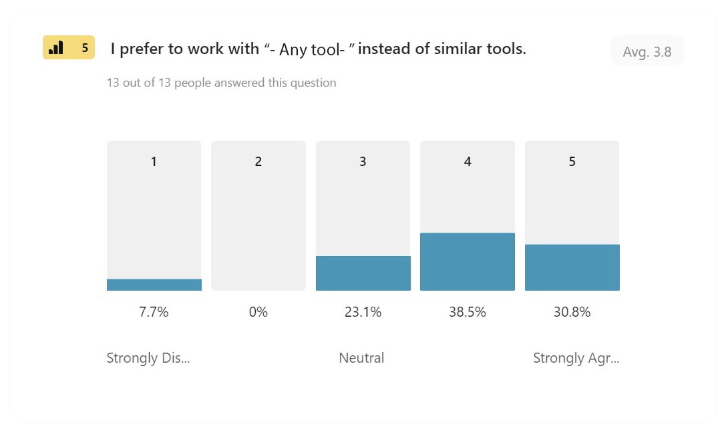
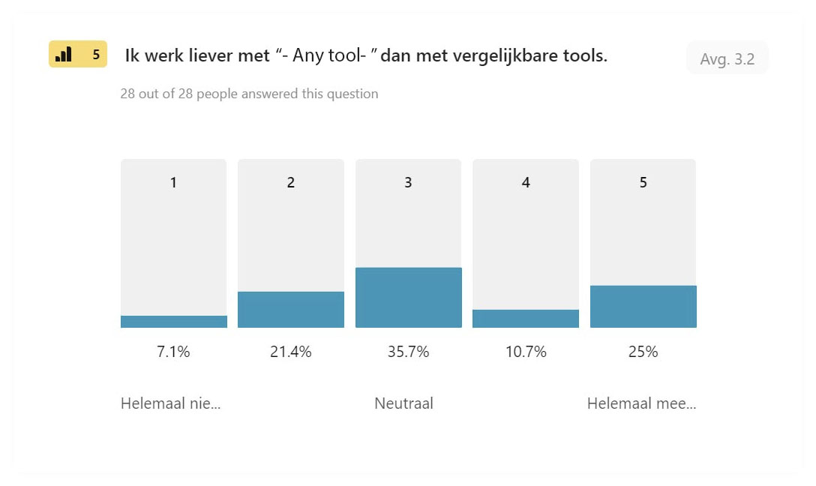
Questions & Answers #5
I prefer to work with “- Any tool- ” instead of similar tools.
General Average
Strongly Disagree
7.4%
Slightly Disagree
10.7%
Neutral
29.4%
Slightly Agree
24.6%
Strongly Agree
27.9%

Slide 19
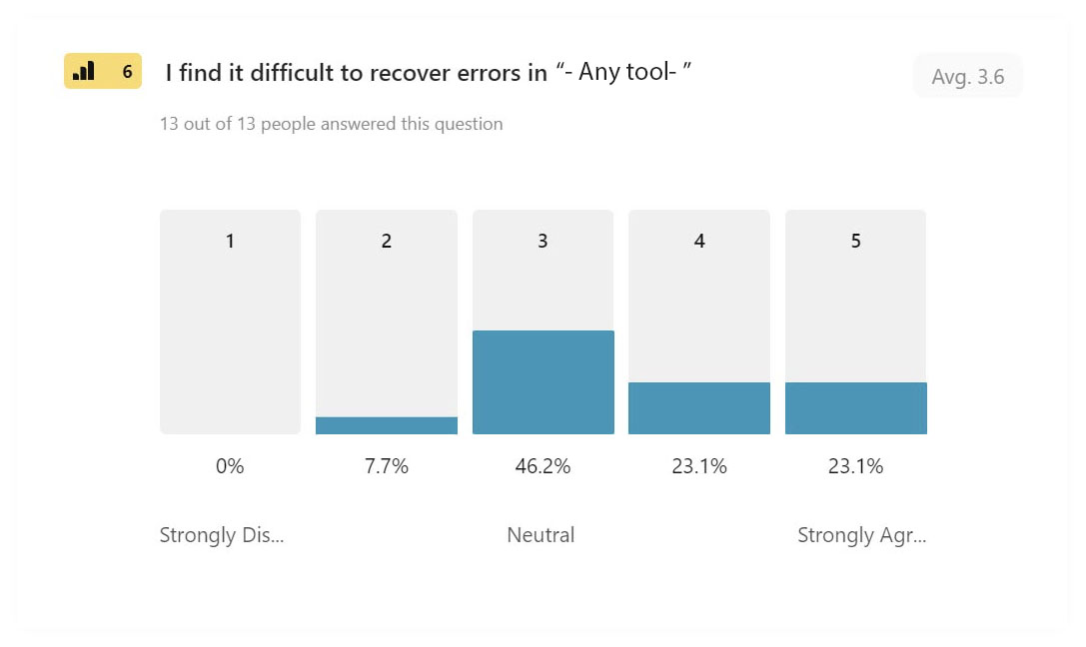
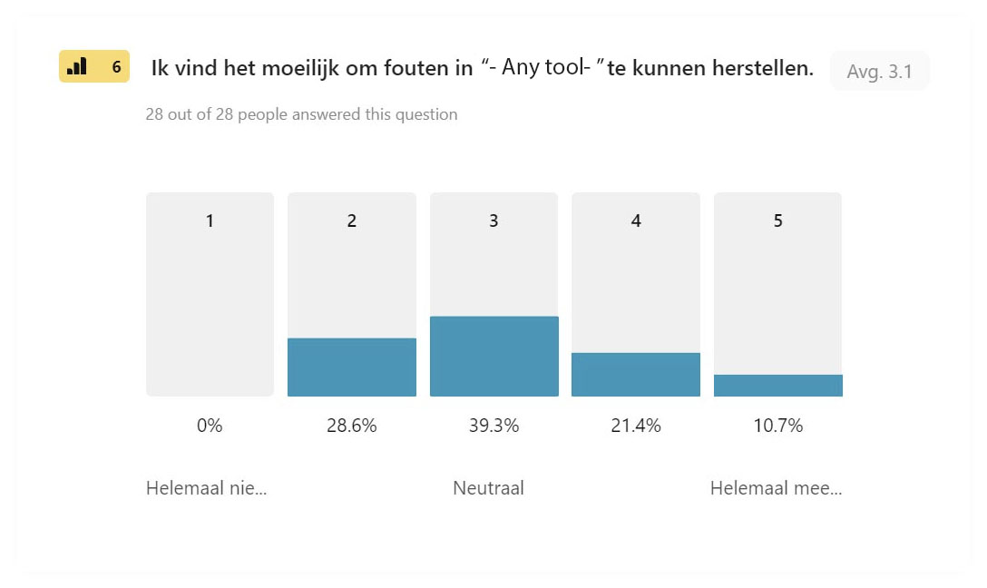
Questions & Answers #6
I find it difficult to recover errors in “- Any tool- ”.
General Average
Strongly Disagree
0%
Slightly Disagree
18.1%
Neutral
42.8%
Slightly Agree
22.2%
Strongly Agree
16.9%

Slide 20
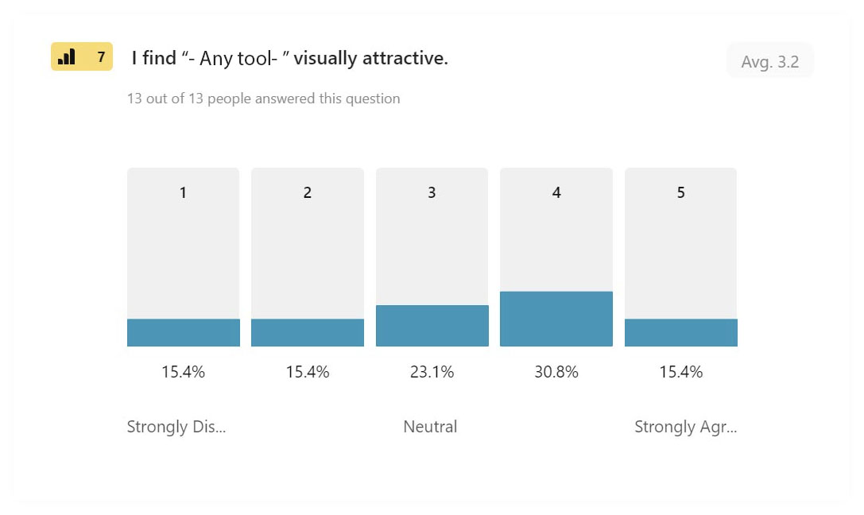
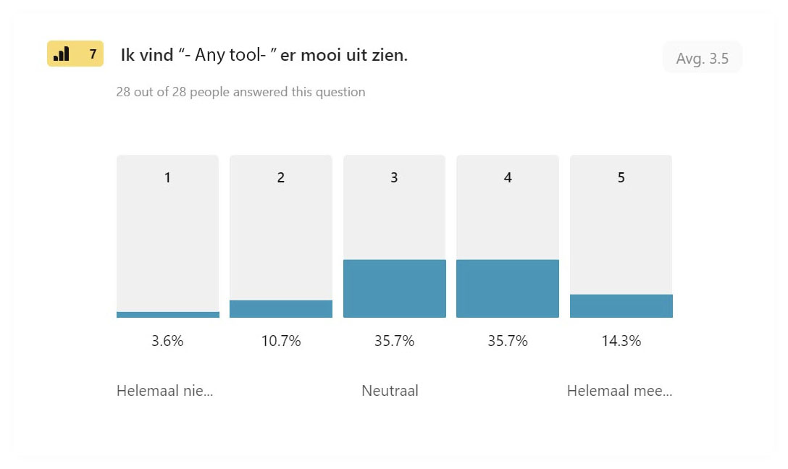
Questions & Answers #7
I find “- Any tool- ” visually attractive.
General Average
Strongly Disagree
9.5%
Slightly Disagree
13%
Neutral
29.4%
Slightly Agree
33.3%
Strongly Agree
14.8%

Slide 21
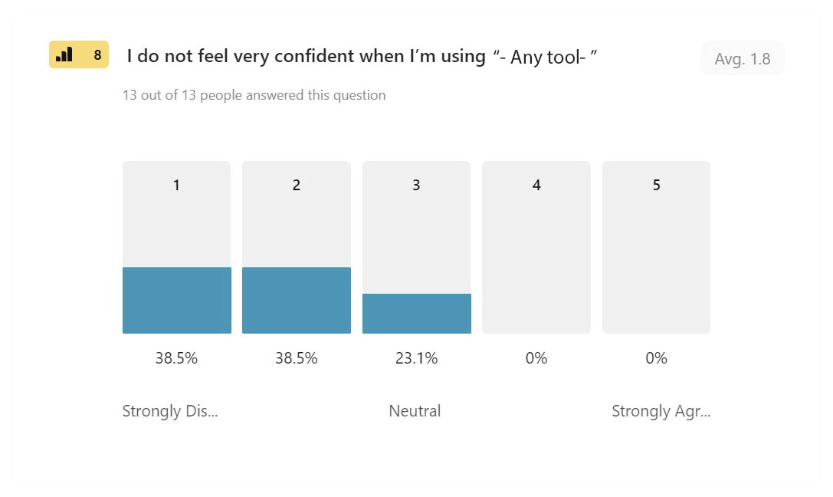
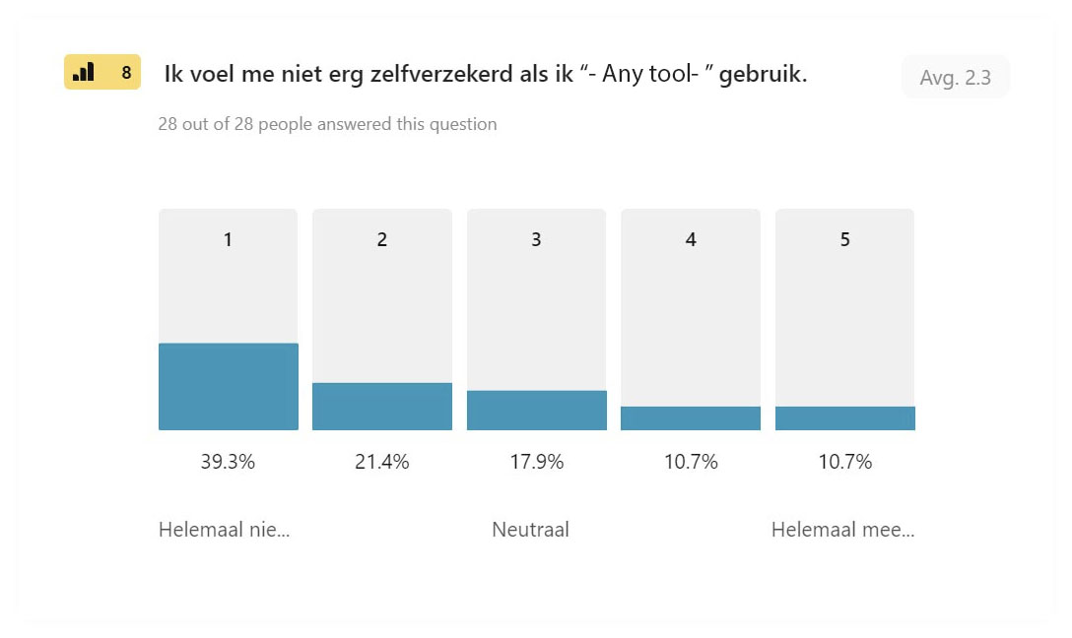
Questions & Answers #8
I do not feel very confident when I’m using “- Any tool- ”.
General Average
Strongly Disagree
38.9%
Slightly Disagree
30%
Neutral
20.5%
Slightly Agree
5.3%
Strongly Agree
5.3%

Slide 22
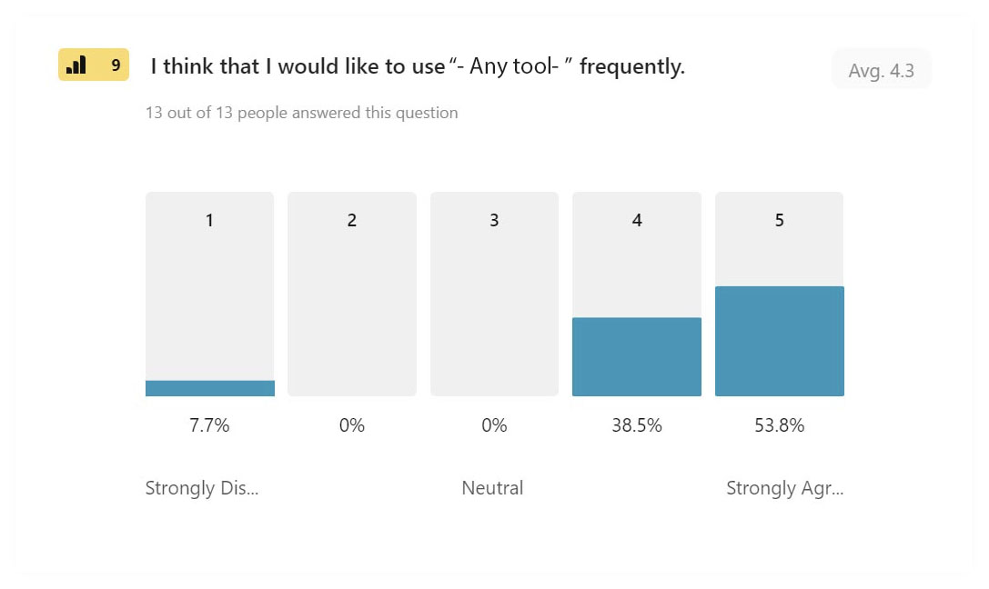
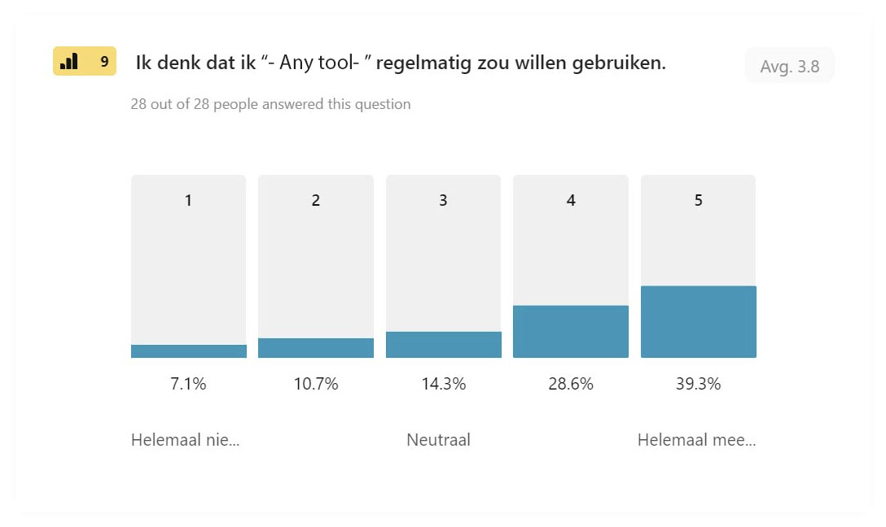
Questions & Answers #9
I think that I would like to use “- Any tool- ” frequently.
General Average
Strongly Disagree
7.4%
Slightly Disagree
5.3%
Neutral
7.1%
Slightly Agree
33.6%
Strongly Agree
46.6%

Slide 23
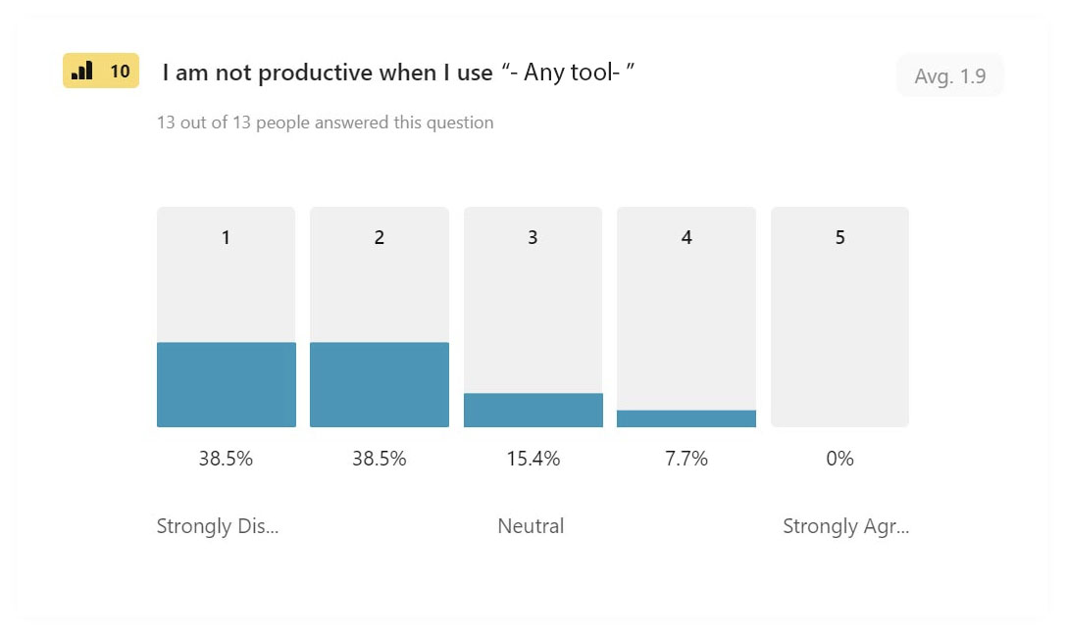
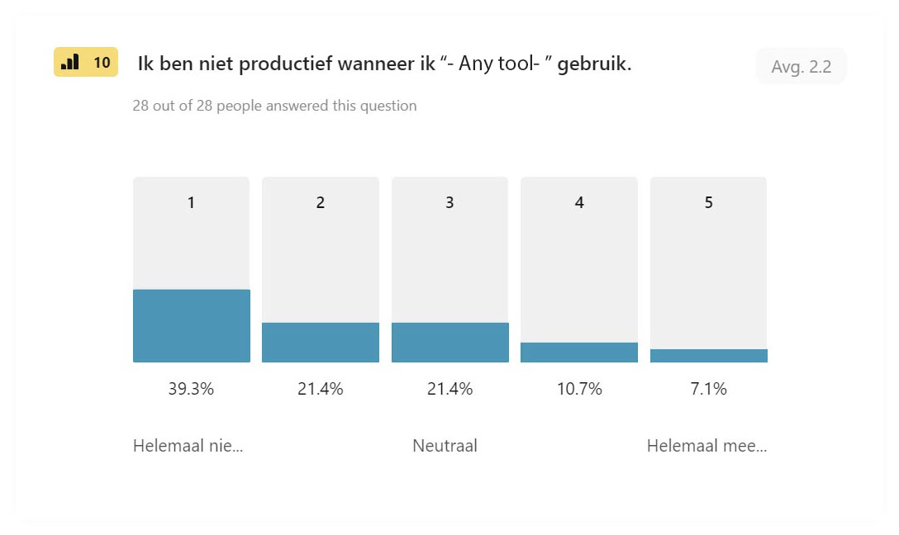
Questions & Answers #10
I am not productive when I use “- Any tool- ”.
General Average
Strongly Disagree
38.9%
Slightly Disagree
30%
Neutral
18.4%
Slightly Agree
9.2%
Strongly Agree
3.5%

Slide 24
Positive & negative response balance #1
“- Any tool- ” is easy to use.
To calculate positive answers on positive questions, the values of "strongly agree" and "slightly agree" values were collected.
To calculate positive answers on negative questions, the values of "strongly disagree" and "slightly disagree" values were collected.

Slide 25
Positive & negative response balance #2
Using “- Any tool- ” does not help me in my work.
To calculate positive answers on positive questions, the values of "strongly agree" and "slightly agree" values were collected.
To calculate positive answers on negative questions, the values of "strongly disagree" and "slightly disagree" values were collected.

Slide 26
Positive & negative response balance #3
After onboarding, I quickly started using “- Any tool- ”.
To calculate positive answers on positive questions, the values of "strongly agree" and "slightly agree" values were collected.
To calculate positive answers on negative questions, the values of "strongly disagree" and "slightly disagree" values were collected.

Slide 27
Positive & negative response balance #4
I need a lot of help to use new “- Any tool- ” functionalities.
To calculate positive answers on positive questions, the values of "strongly agree" and "slightly agree" values were collected.
To calculate positive answers on negative questions, the values of "strongly disagree" and "slightly disagree" values were collected.

Slide 28
Positive & negative response balance #5
I prefer to work with “- Any tool- ” instead of similar tools.
To calculate positive answers on positive questions, the values of "strongly agree" and "slightly agree" values were collected.
To calculate positive answers on negative questions, the values of "strongly disagree" and "slightly disagree" values were collected.

Slide 29
Positive & negative response balance #6
I find it difficult to recover errors in “- Any tool- ”.
To calculate positive answers on positive questions, the values of "strongly agree" and "slightly agree" values were collected.
To calculate positive answers on negative questions, the values of "strongly disagree" and "slightly disagree" values were collected.

Slide 30
Positive & negative response balance #7
I find “- Any tool- ” visually attractive.
To calculate positive answers on positive questions, the values of "strongly agree" and "slightly agree" values were collected.
To calculate positive answers on negative questions, the values of "strongly disagree" and "slightly disagree" values were collected.

Slide 31
Positive & negative response balance #8
I do not feel very confident when I’m using “- Any tool- ”.
To calculate positive answers on positive questions, the values of "strongly agree" and "slightly agree" values were collected.
To calculate positive answers on negative questions, the values of "strongly disagree" and "slightly disagree" values were collected.

Slide 32
Positive & negative response balance #9
I think that I would like to use “- Any tool- ” frequently.
To calculate positive answers on positive questions, the values of "strongly agree" and "slightly agree" values were collected.
To calculate positive answers on negative questions, the values of "strongly disagree" and "slightly disagree" values were collected.

Slide 33
Positive & negative response balance #10
I am not productive when I use “- Any tool- ”.
To calculate positive answers on positive questions, the values of "strongly agree" and "slightly agree" values were collected.
To calculate positive answers on negative questions, the values of "strongly disagree" and "slightly disagree" values were collected.

Slide 34
Top 5 questions with the most positive response
Our users want to use “- Any tool- ” frequently. (80.2%)
Our users thinking that using “- Any tool- ” helps in their business. (76.4%)
Our users feeling productive when using “- Any tool- ”. (68.9%)
Our users feel very confident while using “- Any tool- ” (68.9%)
Our users prefers “- Any tool- ” instead of other similar tools. (52.5%)
It is remarkable that the positive answers we received are related to business value.
After these answers, it is clear that users feel more comfortable and productive after getting used to using the “- Any tool- ”.

Slide 35
Top 5 questions with the most negative response
Our users often need assistance while using “- Any tool- ”. (24.3%)
Our users think that the “- Any tool- ” visually is not attractive. (22.5%)
Our users find “- Any tool- ” difficult to use. (20.2%)
Our users have the possibility to choose another similar tool in the future. (18.1%)
Our users find it difficult to recover errors in “- Any tool- ”. (18.1%)
Most of the negative responses we received are more related to the complexity of the user interface and lack of interaction. It is very important to increase the satisfaction of users in the short term by making the interface more optimal.

Slide 36
What actions should be taken with positive questions?
We can say that our users are generally satisfied with the features of “- Any tool- ”.
Possible actions to be taken may bring us more customer satisfaction.
Understanding the most desirable features and involving users in this step.
Compare “- Any tool- ” with other tools and make our weak sides better, improve our good features even more.

Slide 37
What actions should be taken with negative questions?
It is clear that our users having some problems while using the “- Any tool- ”s interface.
Possible actions to be taken may bring us more customer satisfaction.
Improve the usability of the interface
Using similar design patterns that users are used to. UX laws lead to design changes
Get rid of the inconsistency
Providing more documentation to users
Improve CSM
Creating more interaction feedback between system and user

Slide 38
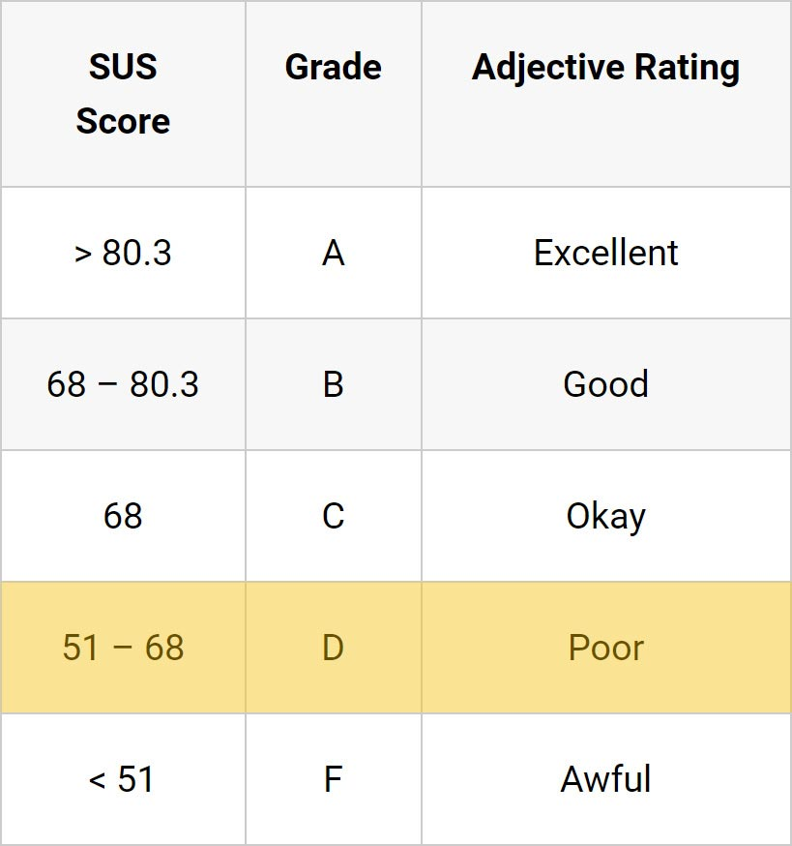
About SUS Test
Considering the answers given by our users, it is seen that “- Any tool- ” has an average of 63.5 and is in the "poor" band.
Firstly, it should be aimed to increase this result to the "good" band with some improvements.

Slide 39
Recommendations
According to the results, “- Any tool- ”s grade appears to be below the average.
It is very important to take certain measures to correct this in the short and long term.
In the short term, it is important that consultants support users who need assistance. (You can see name-based SUS results on the next pages)

Slide 40
Recommendations
Once users get used to using “- Any tool- ”, they feel more comfortable and their satisfaction will increase, they are more likely to stay with our tool, choose to buy more licenses or modules, and promote “- Any tool- ” amongst colleagues or peers within other organizations.

Slide 41
Recommendations
According to the results, some interface improvements on the “- Any tool- ” are very important in terms of increasing user satisfaction.
Currently, users seem satisfied with the features of “- Any tool- ”, but they cannot use the product at full performance due to interface problems.

Slide 42
Recommendations
Therefore, it is very vital to solving important problems as soon as possible. (such as error handling, navigation complicity, general search option, add zoom buttons into the canvas, image upload, etc.)

Slide 43
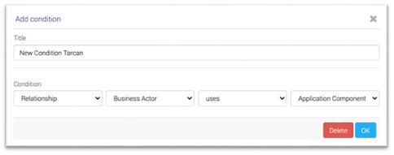
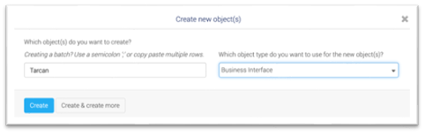

Examples of topics that need to be improved (example)
Consistency about button placement (I also added many screens too)

Slide 44
Last Recommendations
It is recommended to:
Release new features, based on research metrics within the next 4-6 months;
Release a more extensive support/FAQ/community environment;
Complete another SUS test again within 6 months;
Complete another SUS test, including a wider variety of user-types, based on role and “- Any tool- ” experience, realized by Development working together with the Support and CXM department*.

Slide 45
Users who feel comfortable while using “- Any tool- ”.
TOP 5
Person A – Company A (Sus Score: 95) – 127 web session
Person B – Company B (Sus Score: 92.5) - 1058 web session
Person C – Company C (Sus Score: 90) - 834 web session
Person D – Company D (Sus Score: 90) – 587 web session
Person E – Company E (Sus Score: 87.5) - 52 web session
Person F – Company F (Sus Score: 87.5) - 1872 web session
You can find the detailed name-based list in the next pages

Slide 46
Users who feel uncomfortable while using “- Any tool- ”.
TOP 5
Person G – Company G (Sus Score: 15) – 63 web session
Person H – Company H (Sus Score: 17.5) – 198 web session
Person I – Company I (Sus Score: 17.5) – 9 web session
Person J – Company J (Sus Score: 25) – 14 web session
Person K – Company K (Sus Score: 30) – 37 web session
You can find the detailed name-based list in the next pages

Slide 47
Name-based SUS scores
Person A - Company A (95)
Person B - Company A (92.5)
Person C - Company B (90)
Person D - Company C (90)
Person E - Company D (87.5)
Person F - Company E (87.5)
Person G - Company F (85)
Person H - Company G (82.5)
Person I - Company H (80)
Person J - Company I (80)
Person K - Company J(80)
Person L - Company K (77.5)
Person M - Company L (75)
Person N - Company M (72.5)
Person O - Company N (67.5)
Person P - Company N (67.5)
Person Q - Company O (67.5)
Person R - Company P (65)
Person S - Company L (65)
Person T - Company M (62.5)
Person U - Company N (62.5)
Person V - Company O (60)
Person W - Company P (60)
Person X - Company Q (60)
Results below 68 points are considered poor.

Slide 48
Name-based SUS scores
Person Y - Company R (57.5)
Person Z - Company R (57.5)
Person AA - Company S (57.5)
Person AB - Company T (55)
Person AC - Company U (55)
Person AD - Company V (55)
Person AE - Company W (52.5)
Person AF - Company W (45)
Person AG - Company X (37.5)
Person AH - Company X (30)
Person AI - Company Y (25)
Person AJ - Company Y (17.5)
Person AK - Company Z (17.5)
Person AL - Company Z (15)
3 Noname answers (52.5, 60, 65)
Results below 68 points are considered poor.

Slide 49
Thank You
For more detailed information and results, please don't hesitate to contact with Tarcan Yönel.
Mail: tarcan.yonel@anytool.nl Phone: 0638 64 5959

